Slide 1
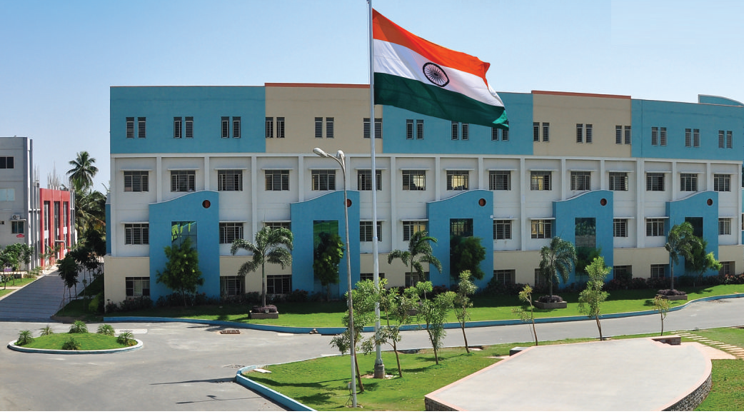
SRI ESHWAR COLLEGE OF ENGINEERING academic year: 2017-18 department: CIVIL section: IV Year
DESIGN PROJECT REVIEW – 1
Date of review: 07/07/2017

Slide 2
Planning, Analyzing & Design of Zero Electricity Power Consumption Apartment
Batch Members
ANUBHARATHI
GNANA PRAKASH
MUHAMMED RAFSAL
SWATHI
Guide Name
Mr. Naveen Arasu A
Asst.Prof/Civil Dept.

Slide 3
Presentation Outline
Abstract
Literature Survey
Need for the study

Slide 4
Abstract of the project
Zero-energy building or zero electricity power consumption apartment, means the total amount of energy used by the building on an annual basis is roughly equal to the amount of renewable energy created by the building itself.

Slide 5
Survey on Existing building
Singapore said Wednesday its flagship R&D project, the Zero Energy Building (ZEB), is on-track to achieve its target of net zero energy consumption in October 2010.
The Zero Energy Building, a super energy efficient building, has achieved zero power consumption and a surplus of 16.3 MWh ( megawatts/hour) of electricity.
The power surplus translates to savings of about 3,900 Singapore dollars (2928.6 U.S. dollars) per month for 35 units of 5-room flats.

Slide 6
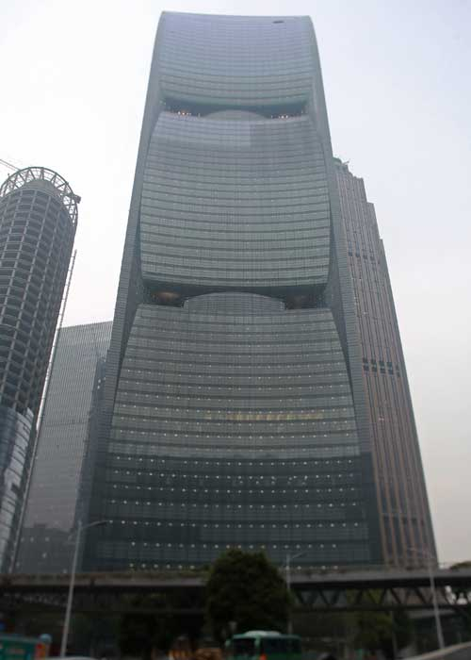

Slide 7
Need for the study
Due to continuous use of renewable resources to generate the electricity and it will be very soon deplicated to over come this problem. We have planed to construct zero electricity consumption apartment.

Slide 8
SPECIFICATION OF APPARTMENTS
Location of apartment - Lakshimi mills, Coimbatore
Type of building - framed structure
Area of the site - 41.5 cents (18000 sq ft)
Plinth area of each floor - 12,000 sq ft
Area of the each house - 1267 Sq.Ft
No of floors - G+4
Number of houses in
each floor - 6 numbers
Solar panels are provided on the roof and elevation of the apartment.

Slide 9
PUBLICATION | TOPIC | INFERENCE | CONCLUSION | ISSUE
INTERNATIONAL JOURNAL OF INNOVATIVE SCIENCE, ENGINEERING &TECHNOLOGY,VOL 4, ISSUE 5, MAY 2015 | ANALYSIS AND DESING OF MULTISTOREYED RESIDENTIAL AND COMMERCIAL BUILDING | THE BUILDING HAVE A SHEAR WALL ARROUND THE LIFT PIT | THE STRUCTURAL RAMP, SHEAR AND RETAING WALL ARE ALSO PROVIDED | MARCH 3,2016
IJRET | ANALYSIS OF HIGH-RISE APPARTMENT ACCIDENT BASED ON FTA | THE PAPER AIMS AT STUDYING AND ANALYSIS ON APPARTMENT FIRE ACCIDENTS AND PROVIDING SOME RECOMMENDATION | THE STUDY REVELS ON THE HIGH-RISE APPARTMENT FIRE | JUNE 2014

Slide 10
PUBLICATION | TOPIC | INFERENCE | CONCLUTION | ISSUE
IRJET | PLANING,DESING & ESTIMATION OF A G+2 RESIDENTIAL APPARTMENT | THE STRUCTUAL PLANNING AND DESIGN REQUIRES IMAGINATION AND SOUND KNOWLEDGE OF STRUCTURAL ENGINEERING | ANALYZING AND EXCEUTING THE PROJECT WE WILL BE ABLE TO LEARN THE PROPER APPLICATION OF ALL SUBJECT | 2017
IIIT | ANALYSIS AND DESIGN OF FLAT SLAB | FLAT SLAB SYSTEM OF CONSTRUCTION ONE IN WHICH THE BEAM USED CONVENTIONAL METHOD | ENCHANCE RESISTANT TO PUNCHING FAILURE AT THE JUNCTION OF CONCTRETE SLAB | 2007

Slide 11
PUBLICATION | TOPIC | INFERENCE | CONCLUTION | ISSUE
IACSIT | ELEVATION DESIGN OF APPARTMENT WITH SOLAR PANEL | UNDER STANDING THE DISTRIBUTION OF DAY LIGHT | THE STUDY FOCUSED ON DESIGNING OF POSITION OF SOLAR PANEL | 2014 FEB
IJIRSET | ANALYS A MULTISTOREY BUILDING WITH BASEISOLATION TECHNIQUES | DUE TO INCREASE IN POPULATION MUTLI STORED BUILDINGS ARE ADOPTED IN LIMITED AREA | STABILITY OF INFILL WALLS ARE THE ADDITIONAL SAFETY | 2012 MAY

Slide 12
PUBLICATION | TOPIC | INFERENCE | CONCLUTION | ISSUE
IOSR | BEHAVIOUR OF ECCENTRICALLY LOADED MODEL SQUARE FOOTING ON REINFORCED SOIL | TYPRS OF REINFORCING MATERIALS ARE GEO TEXTITLES ,KOLOM GEO –GRID& RUBBER GRIDS | RUBBER REINFORCEMENT PROBES TO BE MORE ECONOMICAL AND EFFECTIVE SOIL REINFORCING ELEMENTS
BGSB UNIVERSITY | ANALYSIS AND DESIGN OF THREE STOREY FRAMED BUILING | ONCE THE LOADS OBTAINED THE COMPONENT TAKE LOAD FIRST | SLABES ARE DESIGNED FIRST | 2012 MAY

Slide 13
PUBLICATION | TOPIC | INFERENCE | CONCLUTION | ISSUE
IACSIT | ELEVATION DESIGN OF APPARTMENT | UNDER STANDING THE DISTRIBUTION OF DAY LIGHT IN A ROOM IS ESENTIAL | THE STUDY FOCUSED ON DESIGNING OF WALL OPENINGS | 2014 FEB
IJIRSET | ANALYS AND DESIGN OF MULTISTOREY BUILDING WITH BASEISOLATION TECHNIQUES | DUE TO INCREASE IN POPULATION MUTLI STORED BUILDINGS ARE ADOPTED IN LIMITED AREA | PROPER QUALITY OF CONSTRUCTION AND STABILITY OF INFILL WALLS AND PARTITIONS ARE ADDITIONAL SAFETY | 2015 MAY

Slide 14


Slide 15
S.NO | DATE | WORK TO BE DONE | REMARKS
1 | 07-07-2017 | Line Plan ( Zeroth Review)
2 | 17-07-2017 | Detailed Plan In AutoCAD Approval from Guide
3 | 22-07-2017 | Detailed Plan, Section & Elevation ( First Review)
4 | 09-08-2017 | Analysis and Design by manual design
5 | 12-08-2017 | Check the analysis with STADD PRO
6 | 19-08-2017 | Structural design
7 | 08-09-2017 | Locating the solar panels.
8 | 18-09-2017 | Conclusion ( Third Review)
9 | 28-09-2017 | Final Review – Book Submission

Slide 16
Queries?

Slide 17
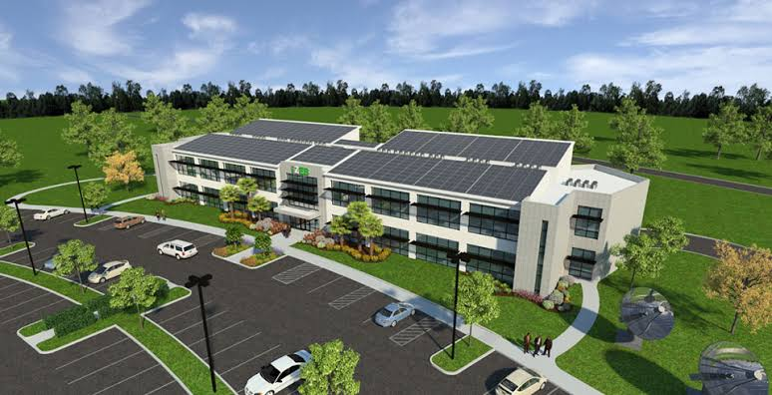
THANK YOU

